Slide 1

Manchester Raspberry Jam 36
April 2016

Slide 2
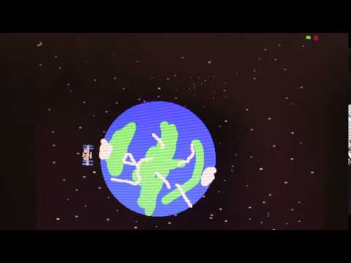
Last Time:

Slide 3
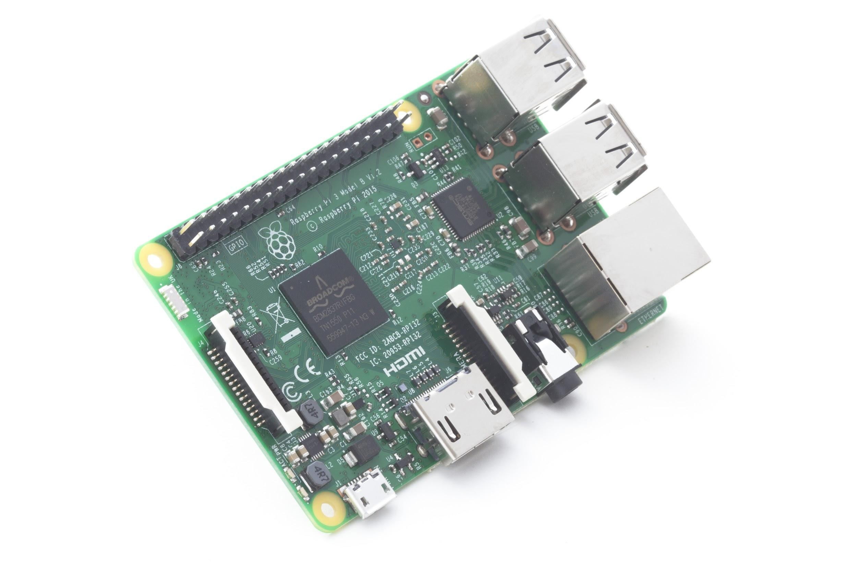
In the news:

Slide 4
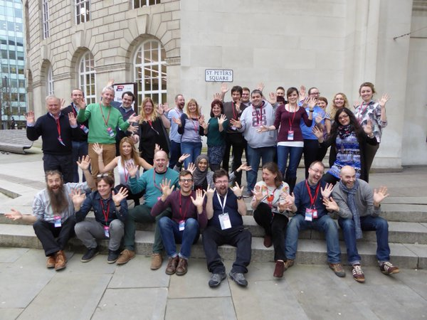
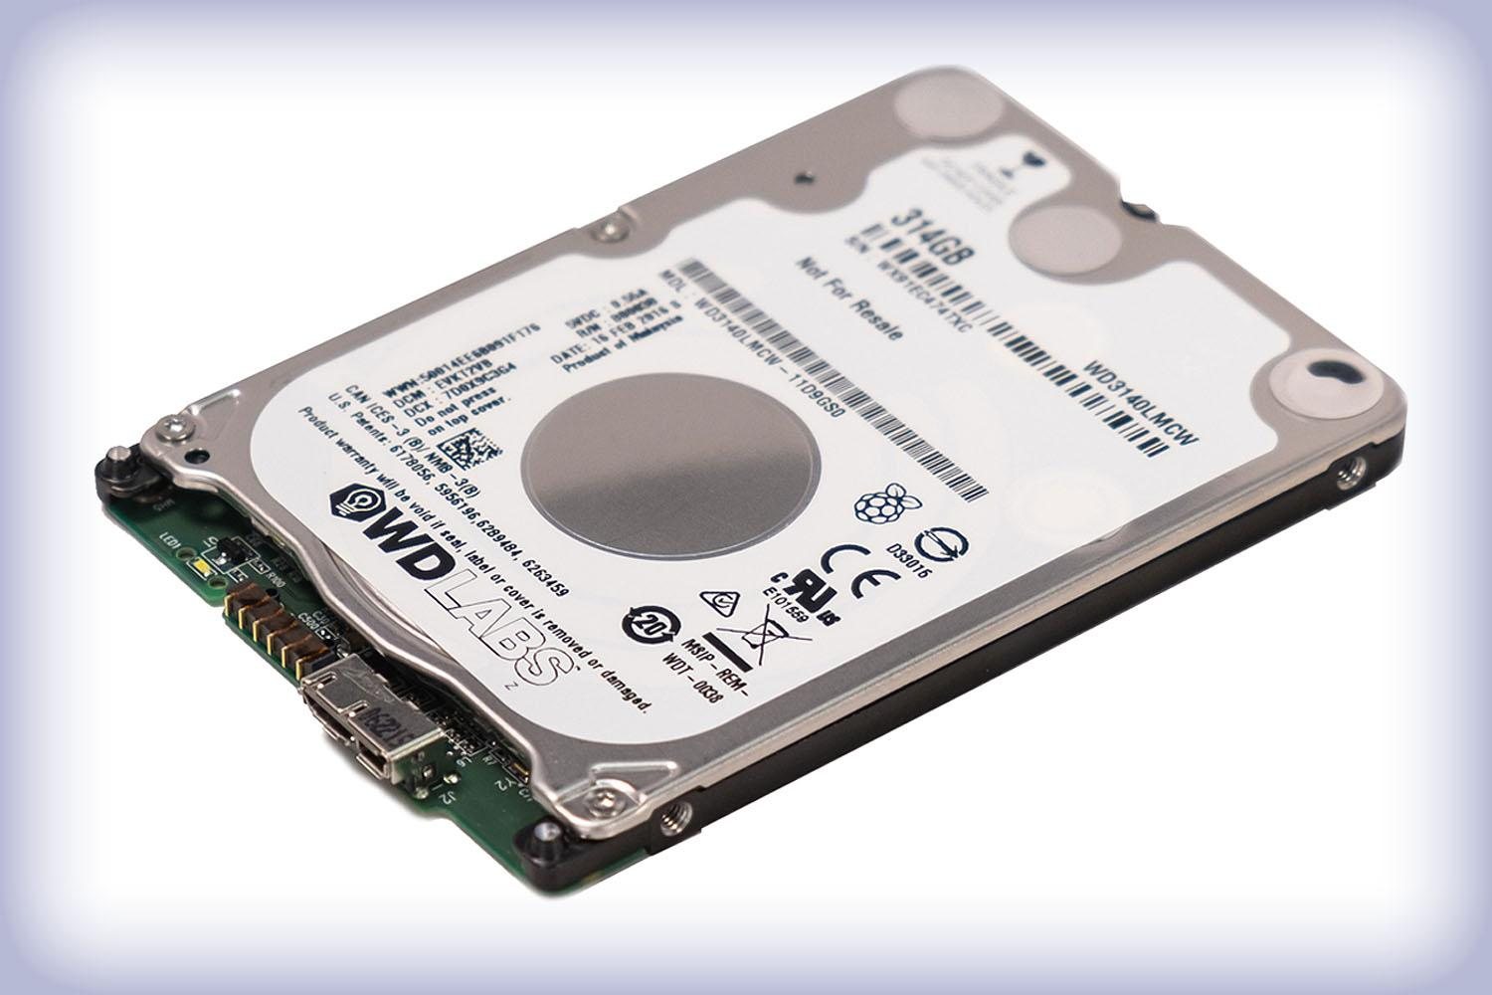
In the news:

Slide 5
Workshops & Activities
Morning:
Starters workshop
Scratch and Minecraft: Pi Edition
Easter egg hunt in Scratch
Easter egg hunt in Minecraft
All day: Robot obstacle course

Slide 6
Today:
10:30 - Getting Started workshop
11:00 - Scratch & Minecraft workshop
13:30 - Lunch
WiFi:
SSID MMU-Visitor
Pass. University
Next Jam:
Saturday 11th June Tickets up shortly
Share photos with #McrRaspJam
Slides and other downloads at: bit.ly/McrRaspJam

